Slide 1
Slower than light
by Dương Viết Dũng

Slide 2
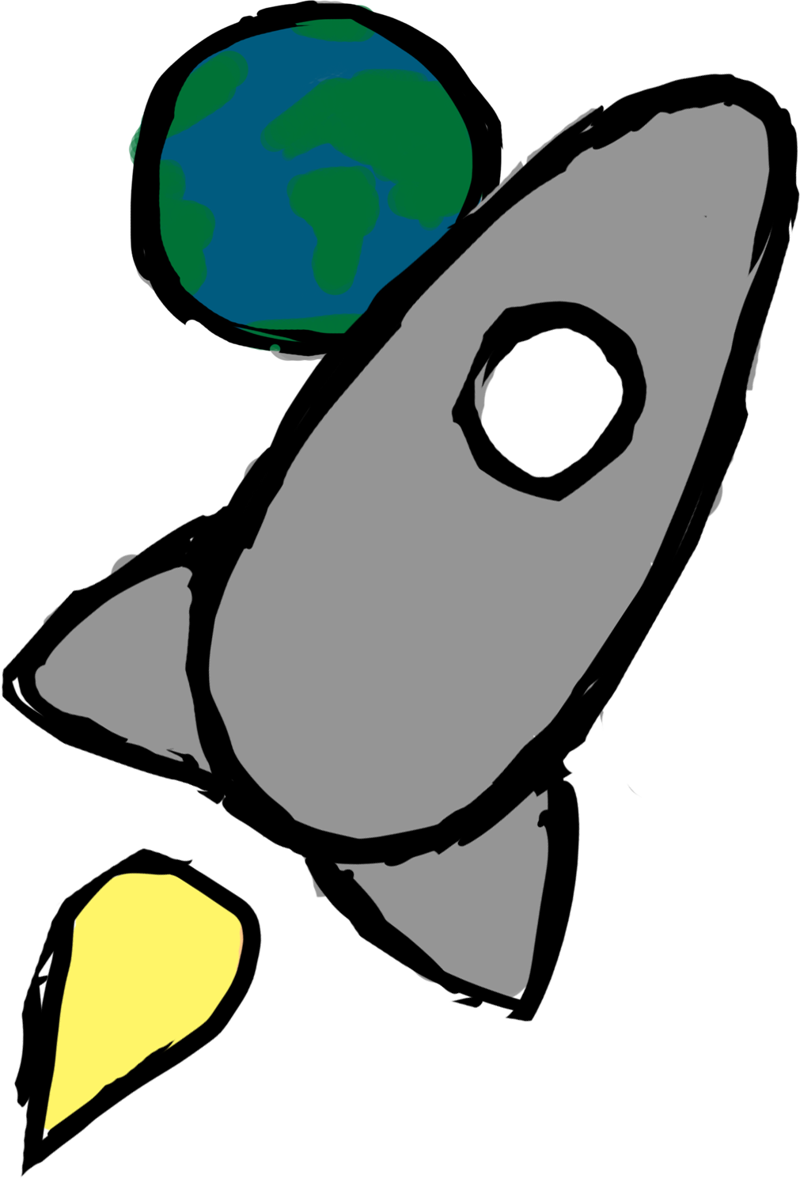
Overview
Control a spaceship
(Relatively) scientifically accurate
Explore the universe
Inspired by:
The Martian
Interstellar
Gravity

Slide 3

Mechanic: Booster
No drag in space
Inertia is everything
Limited fuel

Slide 4

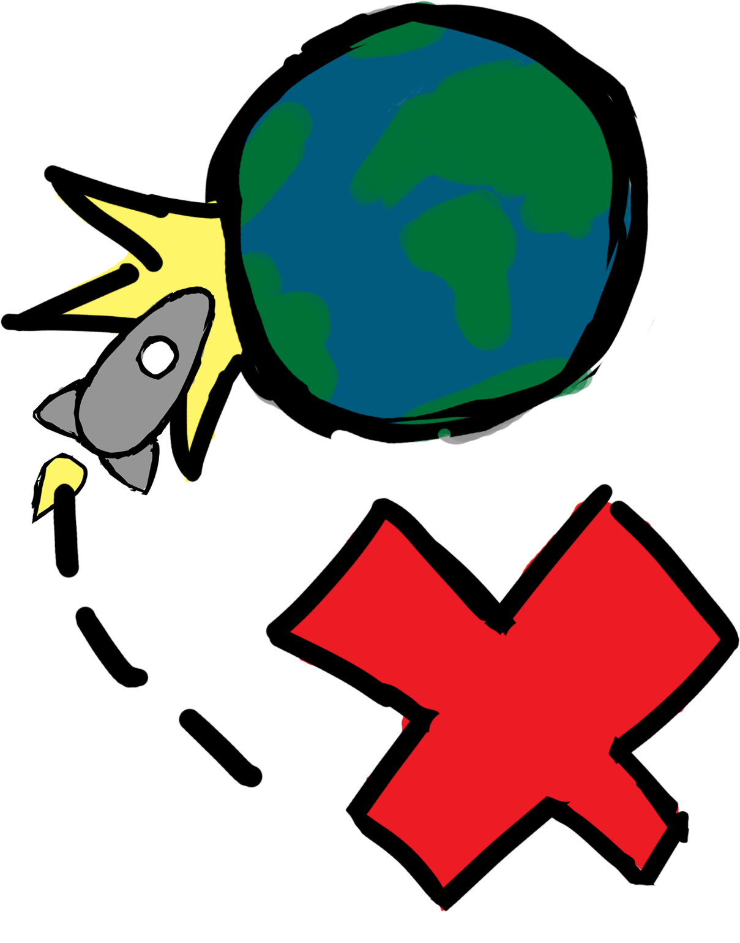
Mechanic: Gravity

Slide 5

Mechanic: Celestial object
Different objects has different pulls.
Celestial objects will move.
Don’t go where it is, go where it will be!
Planets
Asteroid belts
Blackhole

Slide 6
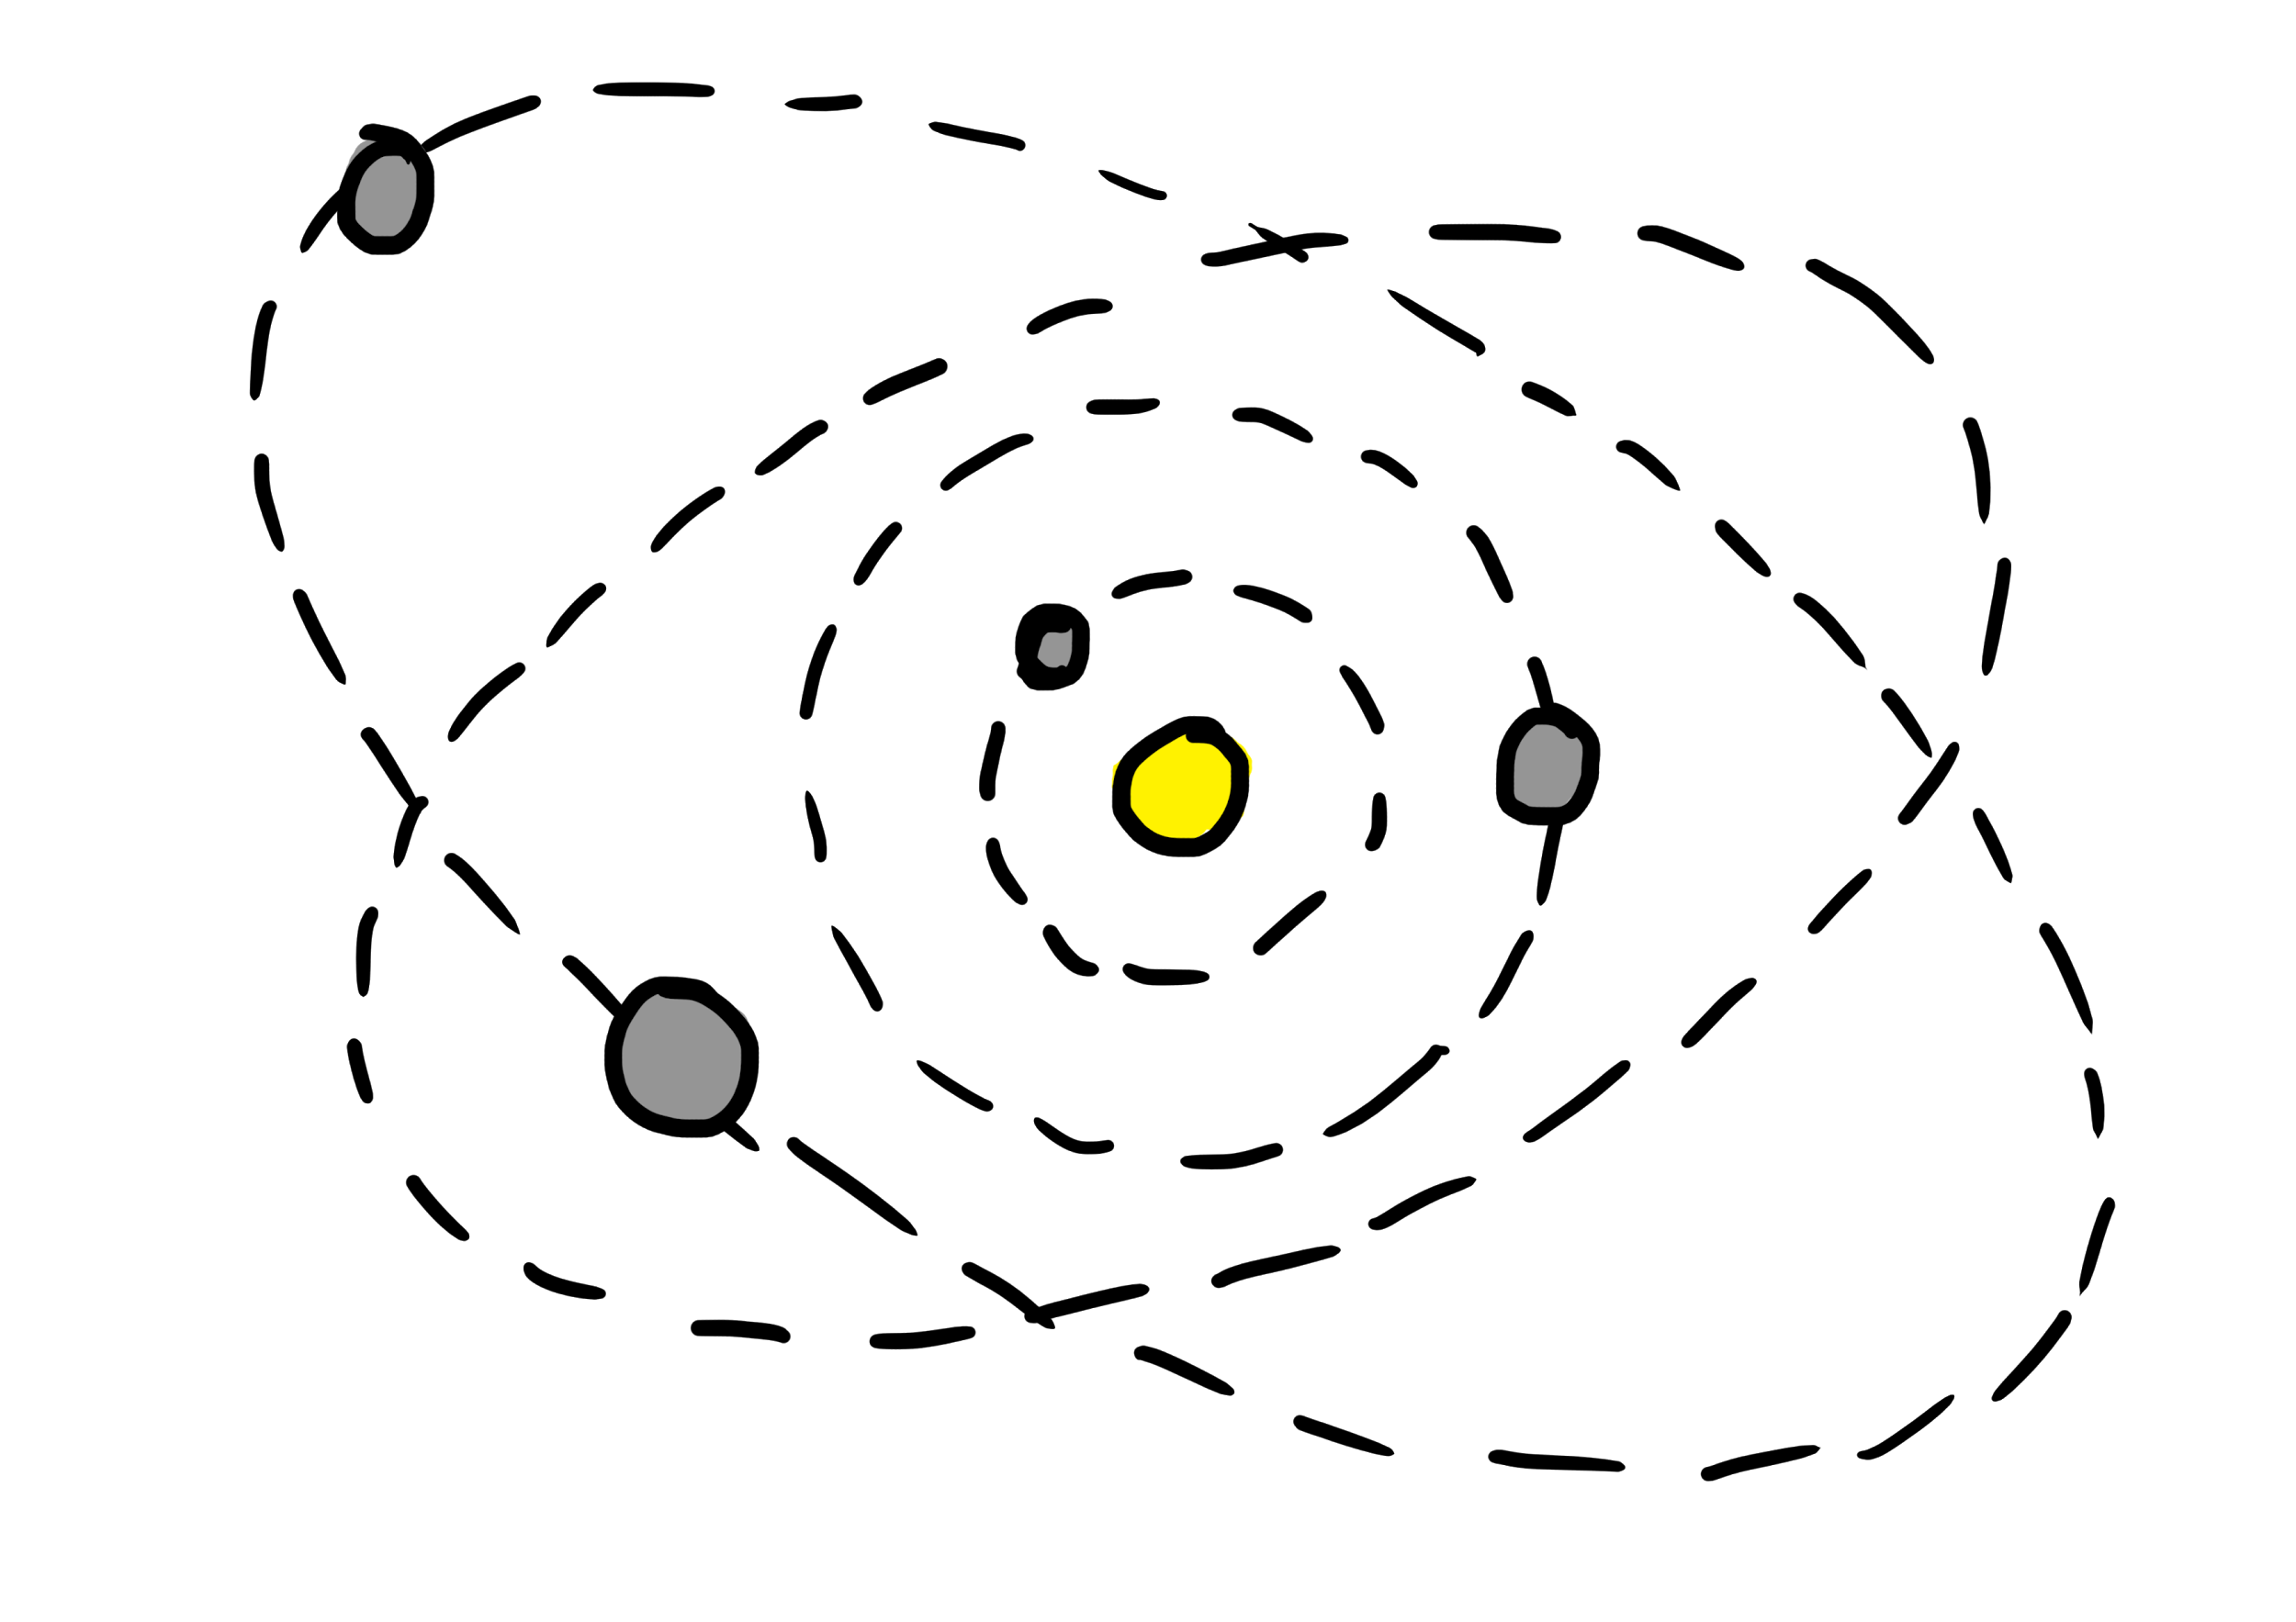
The end

